Slide 1

Text Mining in Online Business Service
Team Members
Roshan Bagla s4447418
Yangyang Xu s4344240
Yukai Qiao s4354963
Zafercan Aygurler s4492528
Saisrikar Paruchuri s4475157

Slide 2
Index
Abstract
Introduction
Dataset
Pre-process Data
NLTK - Lemmatization
NLTK - FreqDist
Word Embedding
Gensim - Word2vec
Gensim - Training Model
Using Vectors to Represent a Sentence
Representing Vectors
Training
Sentence Level
Document Level
Document Level - A CNN Model
Conclusion

Slide 3
Abstract
In our project we focus to make predictions at the instance level by working on the problem of learning classifier.
The approach to the problem of predicting labels for sentences by given labels for reviews we use convolutional neural network to infer sentence similarity.
The given input reviews is taken from IMDB, Amazon, Yelp and then it will predict the review is positive or negative.
We demonstrate the proposed approach is both accurate and scalable compared to various alternatives.

Slide 4
Introduction
As we know, data mining is data driven solution and widely used in many industries. To recognise some patterns behind big data, there are massive algorithms of data mining that support auto-analysis.
Among of these, the framework of data mining helps organise and break down our problem. The positivity or negativity of a customer comment will be a binary-class of this project, data mining regards it as a classification problem.
All processes are done by Python and related libraries that will be mentioned later.

Slide 5
Dataset
For this project, we will be using a dataset containing sentences labelled with positive and negative sentiment.
A sentiment score is associated with each sentence and based on that the sentence is classified as positive and negative.
Score is either 1 for positive and 0 for negative.
These sentences are actual user reviews that are extracted from the different websites like amazon, imdb and yelp.
This data set contains 500 positive and 500 negative user reviews containing 3000 sentences classified into positive and negative sentences.
Comments from the top websites like amazon, yelp and imdb and randomly divide the data into half, one for training and other for testing the documents .
Each review or comment is labelled and has a binary sentiment label either positive or negative then we can analyse the data easily.

Slide 6
Pre-Process Data
Aims: keep important parts, mitigate training pressure, made machine recognisable inputs
Steps:
(1)remove punctuations
(2)lemmatise words
(3)keep adjective, adverb & Proper noun(singular).
(4)tokenise sentence
(5)remove words by frequency <= 5

Slide 7
NLTK - Lemmatization
In NLTK (Natural language Toolkit), lemmatization is a text processing method.
Lemmatization is used to lemmatise different forms of a word into one form.
For verb: Eg. took, taken => take
For noun: Eg. apples, Apple => apple
It helps reduce the size of our word dictionary
Only important words are kept in a sentence.
It helped reduce 20% of the words (in our dataset).
Transform the old sentence to new sentence by removing the similar words.

Slide 8
NLTK - FreqDist
Words having frequency less than 5 do not contribute to train the classifier and are removed.
FreqDist inbuilt function in NLTK is used to remove the words.

Slide 9
Word Embedding
Method: Embeddings = neural network = word2vec
Each document and sentence is represented as a vector of word counts.

Slide 10
Gensim - Word2vec
Gensim is a library which is used to transform the text sentence into vector matrix
Word2vec is a model used for learning vector representation of words called ‘word embeddings’.
Each word will have a vector array that preserves the semantic information about the words that they present.
The final vectors will be pulled to CNN model.

Slide 11
Gensim - Training Model
Sentence = [['so', 'here'], ['good', 'excellent'], [‘great’],...]
# created variable
Model = word2vec (sentences, size=5, window=2, min_count=1)
Gensim uses skip-gram in default, we can set sg=0 to make it CBOW(continue bag of words).
Vector for a word, the model will return an array of vectors (i.e. containing features)
Eg. model.wv [‘way’]→array([-0.06240204, -0.09176608, -0.03593158…]: there will be 5 vectors.
Can also calculate the similarity between the bag of words by using similarity function taking 2 words an input.

Slide 12
Example
model.wv['way’]
array([-0.06240204, -0.09176608, -0.03593158, -0.0451744, -0.03068076],dtype=float32)
model.wv['plug’]
array([ 0.06228806, 0.05816831, 0.01400619, 0.09236281, 0.02532971],dtype=float32)
Similarities:
model.wv.similarity('way', 'plug') = -0.88365797144255442

Slide 13
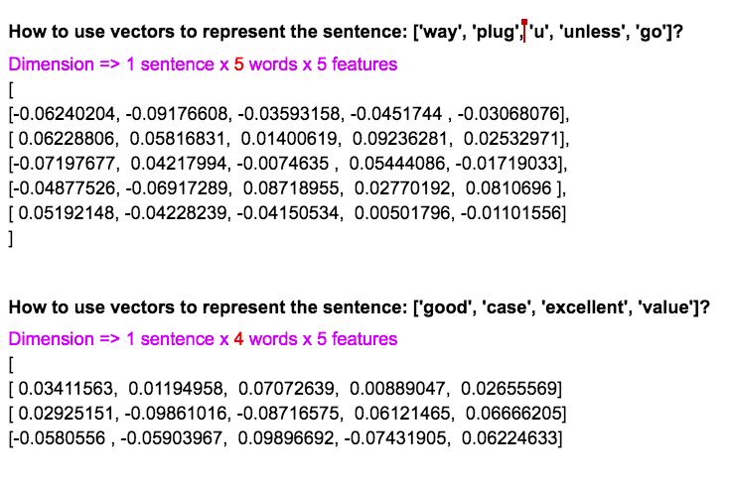
Representing vectors

Slide 14
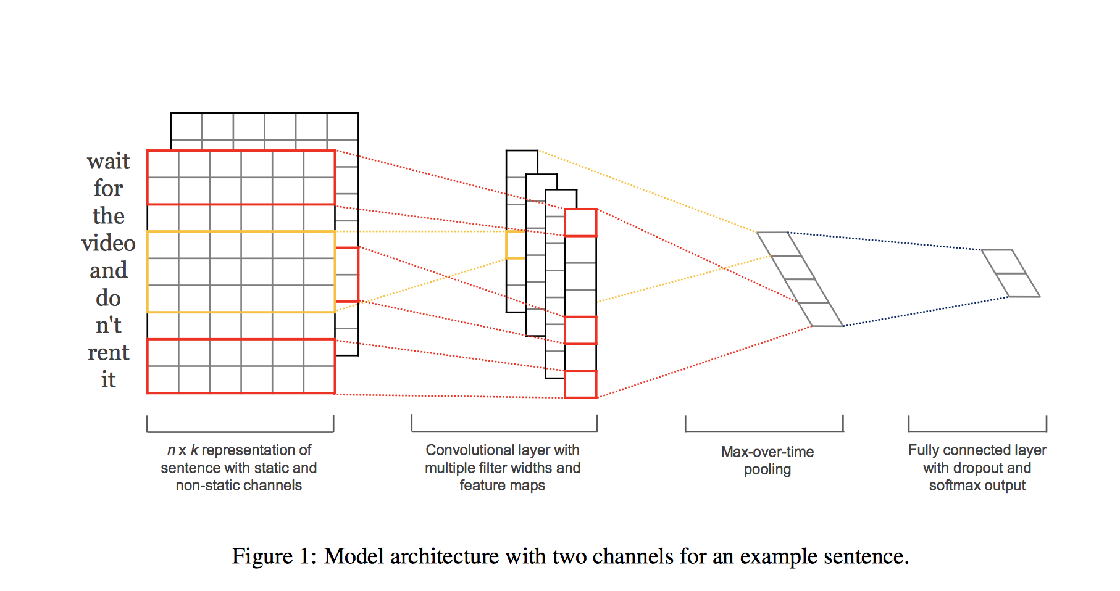
Model
Kim, Y. (2017). Convolutional Neural Networks for Sentence Classification. [online] Arxiv.org. Available at: https://arxiv.org/abs/1408.5882 [Accessed 10 Oct. 2017].
Simplified version of Yoom Kim’s work

Slide 15

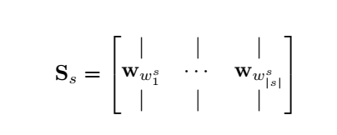
Input:
W : a matrix of word embeddings( ), d = 5 features, V = 10 words
S : a matrix of all sentences, d = 5 features, s = 3 sentences
Output:
0 (Negative)
1 (Positive)

Slide 16
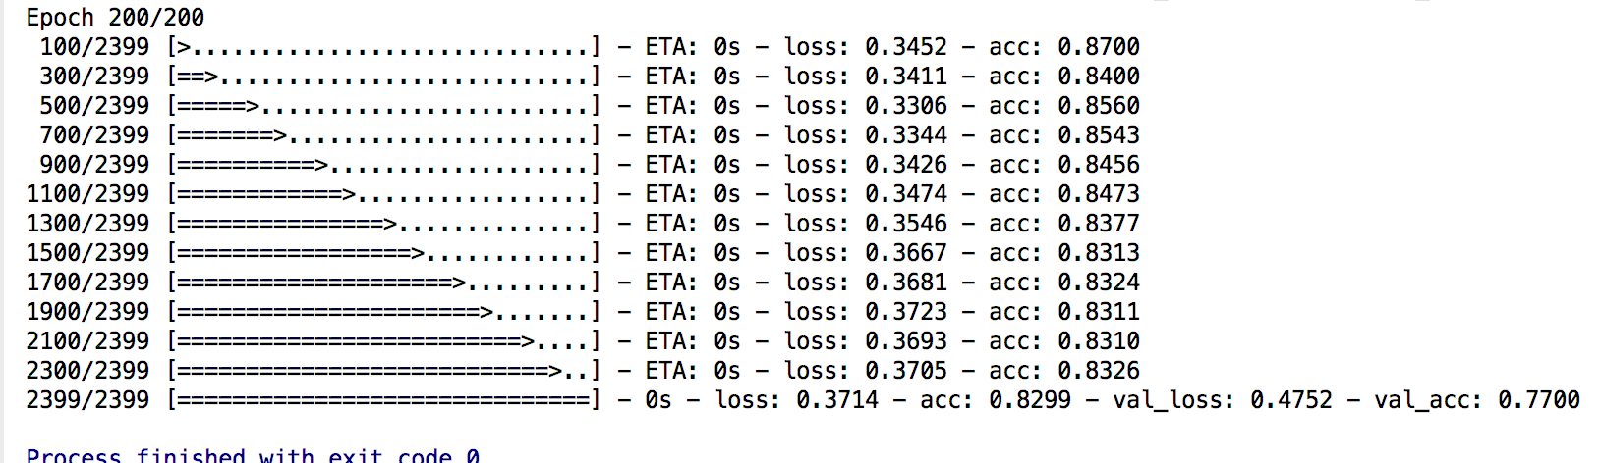
Training
Randomly picked data entries for 3 data sets
Training Set 80% -> Train Model
Validate Set 10% -> Validate Model
Finished a model
Test Set 10% -> Test the model that finished above 2 steps, it’s for giving the ROC graph
Validation Accuracy = 77%

Slide 17
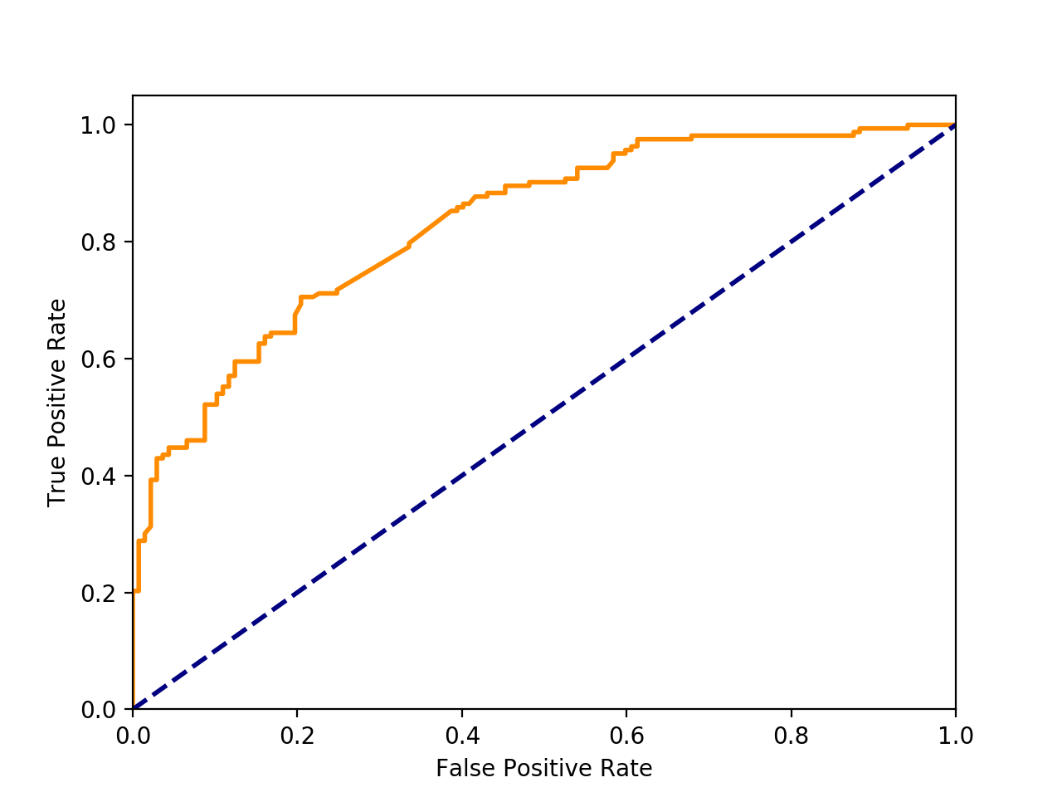
True Negative Rate
The better results the more close to the top left corner.
True Negative Rate
TP Rate = TP/(TP+FN)
Test Accuracy:
76%
FP Rate = FP/(FP+TN)

Slide 18
CONCLUSION
In conclusion, our classifier can classify the comments or sentences with 76% accuracy. The pre-process can affect a lot on results.
The verb words may have sarcasm problem. And too many noun words will reduce final accuracy. Adj. and Adv. benefit to indicate the positive/negative of a sentence.
After knowing the sentiments about the business or products, it can help improving the business. It will save lot of time, as people don’t have to read all the comments about the product however they can get an idea about the product just by reading the sentiment value attached to it.

Slide 19
Thank You!

